Slide 1
等滲透傳輸系統原理與優勢
ISOTONIc
SHOP.COM | 美安台灣公司
© 2017 美安台灣公司版權所有
僅供內部教育訓練使用

Slide 2
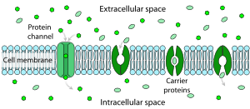
了解維生素礦物質吸收方式
促進性擴散
細胞外隙
蛋白質通道
細胞膜
載體
蛋白質
細胞間隙
Notes:
Here is a diagram of facilitated or carrier-mediated transport through a cell wall. The cell membrane has channels or tunnels going through it. The proteins pick up the nutrients and transport them through the cell wall.

Slide 3
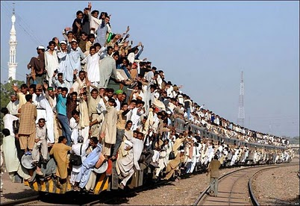
一次就只能裝這麼多

Slide 4
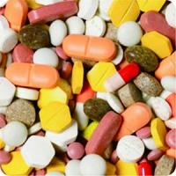
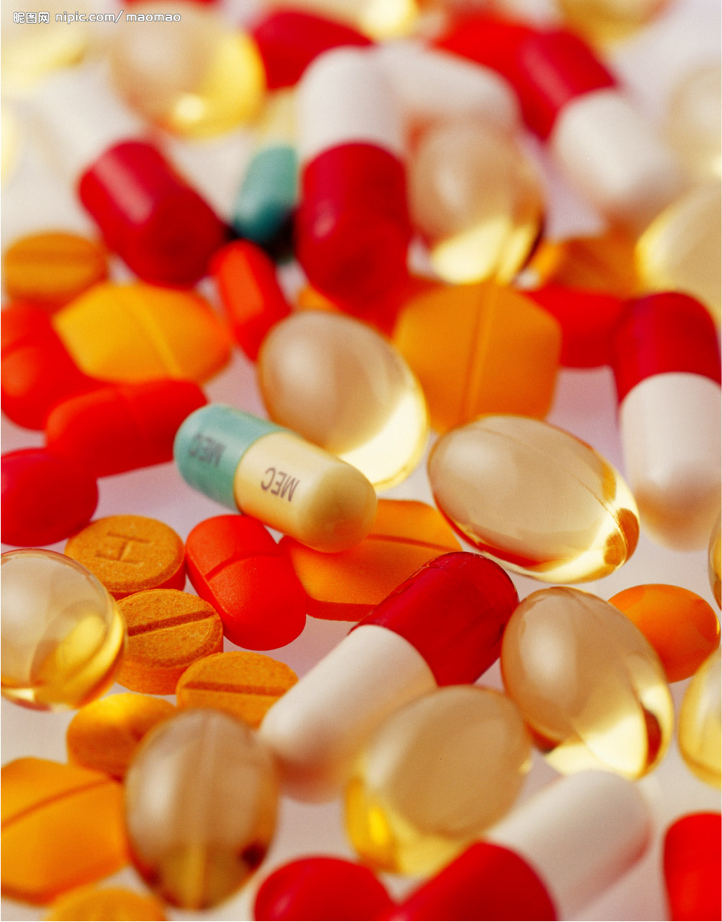
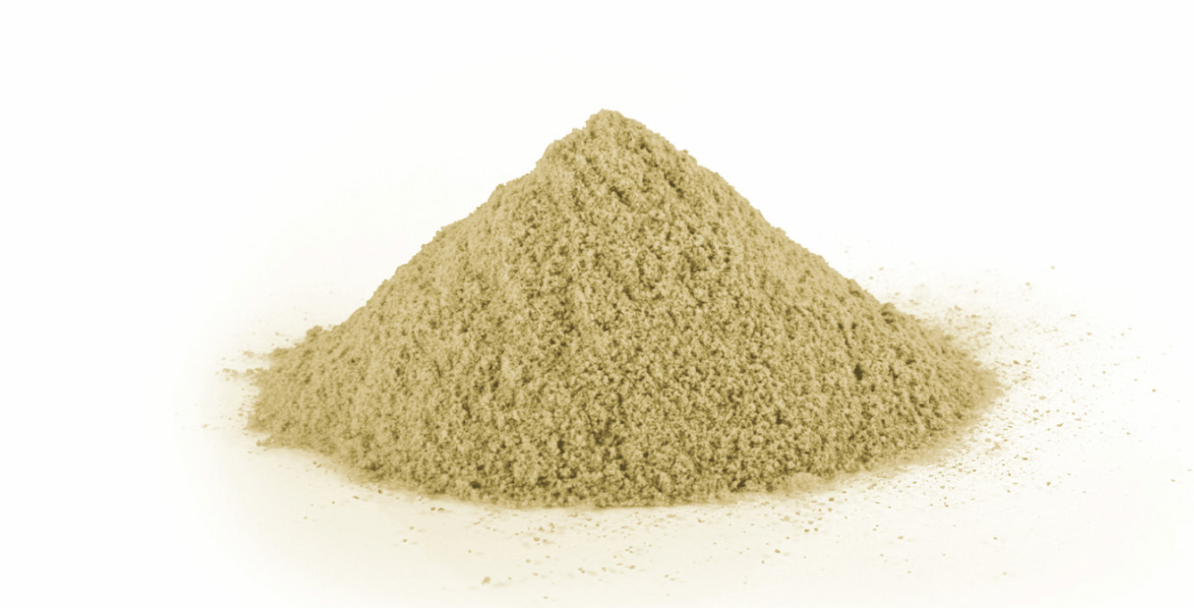
市面上的選擇
錠劑
膠囊
粉劑

Slide 5
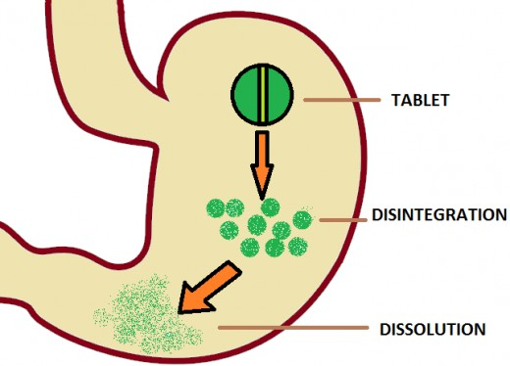
藥丸傳輸系統
藥丸
分解
溶解

Slide 6
藥丸在傳輸上的潛在缺點
藥丸在進入腸道之前可能尚未完全溶解
藥丸可能會卡在胃壁的皺摺中
藥丸可以溶解，但是吞服藥丸時所喝下的水會讓胃將胃中的內容物傾倒至腸道，使吸收部位變得飽和。
Source: D.Y. Graham et al What Happens to Tablets and Capsules in the Stomach…J. Pharm. Sci. 1990, Vol. 79, No. 5 pp 420 - 424

Slide 7
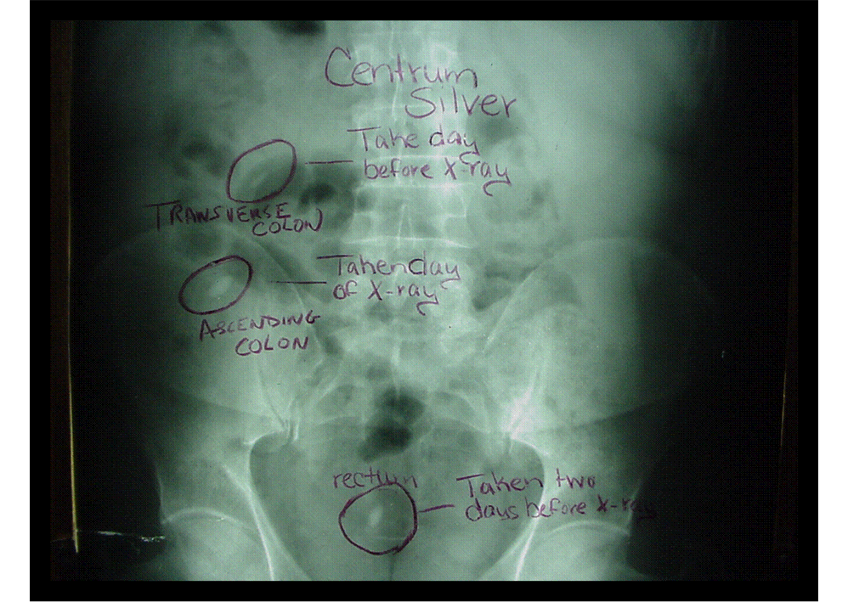
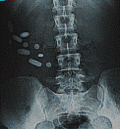
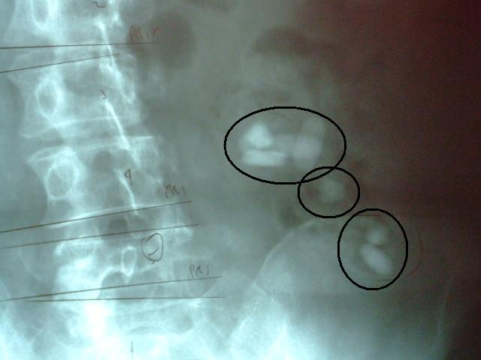
產品名保密

Slide 8
產品名保密

Slide 9
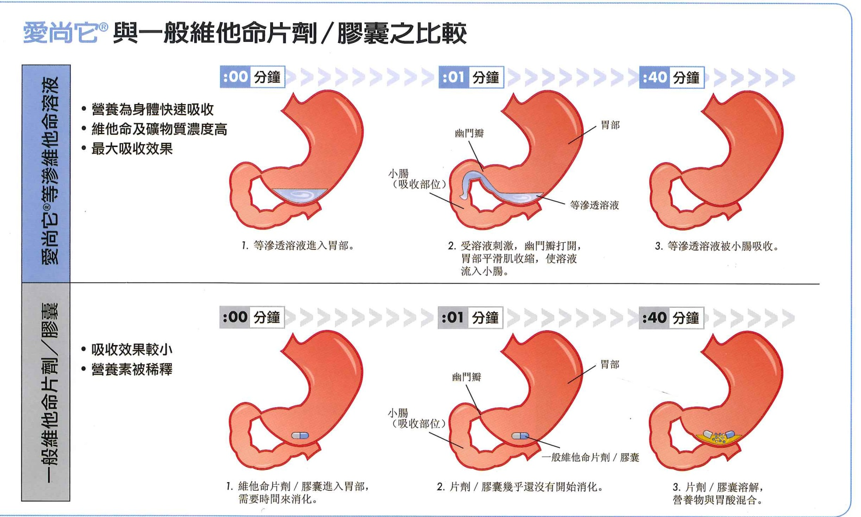
什麼是等滲透？
與身體體液相同的液壓

Slide 10
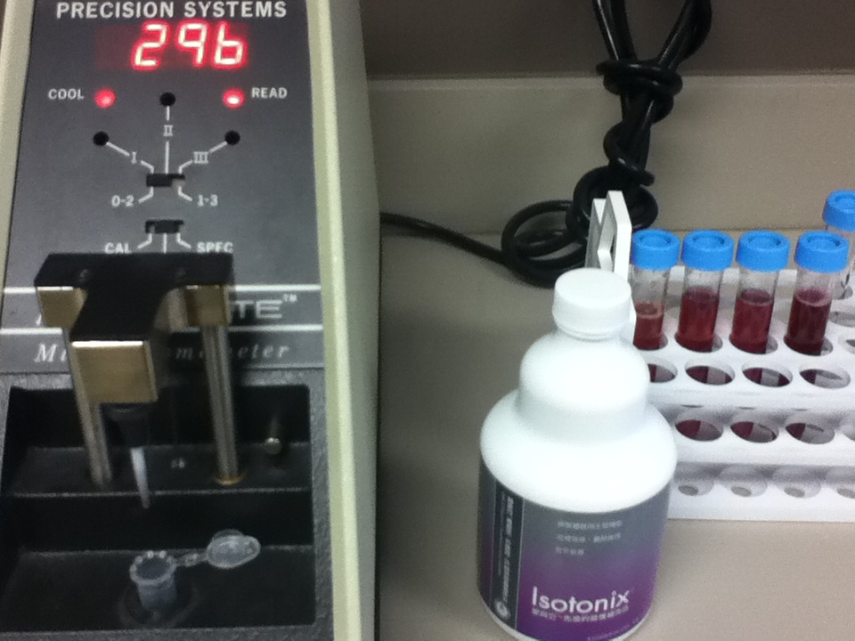
等滲透壓 =
270 - 310 mOsm/kg

Slide 11
為什麼等滲透傳輸如此重要
加速營養素傳輸至血液的速度
預防水份從腸道流失
防止腸胃不適和腹瀉

Slide 12
優勢
1
等滲透產品以最理想的速度清空胃部，讓吸收效果最大化。
快速但受控制；讓您的身體傳輸機制有效地吸收維生素。
Notes:
This brings us to Isotonix Advantage #1. Isotonix products move out of the stomach at an optimal rate to maximize absorption.
It’s fast, but controlled; allowing your body’s transport mechansim to efficiently shuttle vitamins into the blood stream.

Slide 13
碳水化合物控制胃排空率
飲料 | 100 mL 碳水化合物 含量
運動飲料 | 4.6 克
飲料 A | 1.1 克
飲料 B | 2.5 克
水 | 0 克
運動飲料的胃排空率研究
運動飲料的排空率 比水低了 35-45%
Source: Coyle, E.F. et al. Am. J. Physiol. 1999 Vol 276 No 4 pp R997-1002
Notes:
Keeping properly hydrated is very important to athletes. Here is study looking at the rate of gastric emptying of varies athletic drinks and plain water. The rate at which the sports drinks emptied from the stomach correlated well to their sugar content. Gatorade, which had the highest sugar content of the drinks used in this study, emptied 35-45% more slowly than plain water.

Slide 14
每個成分都有多重的功能
成分 | 主要功能 | 第二功能 | 第三功能
果糖 | 控制胃排空 | 滲透壓 | 甜味劑
葡萄糖 | 控制胃排空 | 滲透壓 | 甜味劑
檸檬酸 | 緩衝 | 口味 | 發泡
蘋果酸 | 緩衝 | 口味 | 發泡
二氧化矽 | 乾燥 | 防結塊劑
麥芽糊精 | 控制濕度 | 滲透壓 | 口感
碳酸氫鉀 | 緩衝 | 發泡
硫酸鈣 | 乾燥 | 防結塊劑

Slide 15
多快才算得上快？
藥錠在離開胃時只有部分溶解
與基線比較，血漿中自由基減少率 [單位/分鐘]
OPC-3 等滲透配方
OPC-3 錠
使用後時間 [分鐘]
M.R. Cesarone, et al. Phytother. Res. 2009
Notes:
So how fast is “fast?”
Here is a study done with OPC-3 in Isotonix form and tablet form. The reduction in free radicals in the blood was monitored over time. The red bars, representing Isotonix OPC-3 took only 7-8 minutes after consumption to achieve maximum activity in the blood. While the same amount of OPC-3 in tablet form slowly built up concentration in the blood over a period of 1 hour. One reason for this is because the tablet, which was formulated to immediately release, was propelled into the intestine before it fully dissolved. This is because the water used to take the pill could not control gastric empyting like an Isotonix solution.

Slide 16
優勢
等滲透產品保護營養素，在胃中不因鹽酸而降低營養價值。
酸鹼度穩定
顧客的每一分錢都不會浪費
2

Slide 17
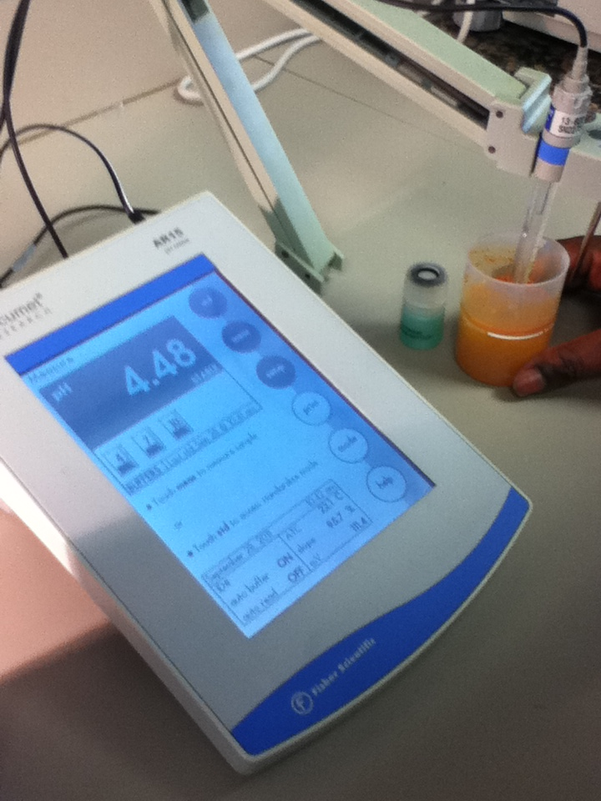
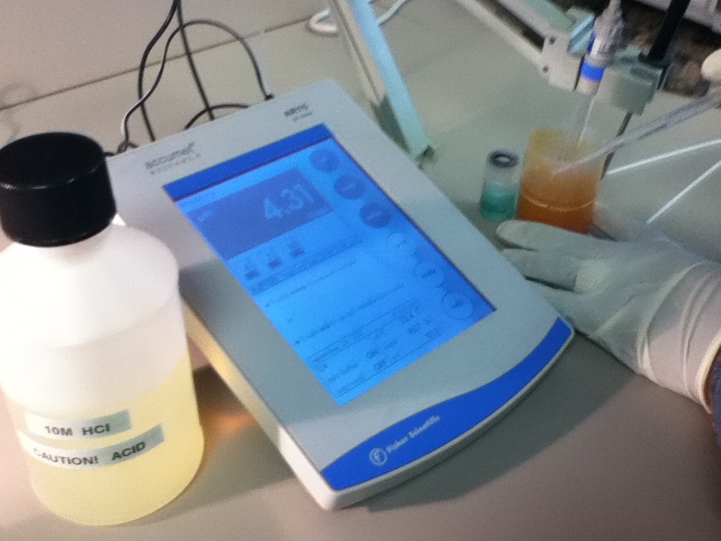
當iSOTONIC 綜合維生素
遇到高濃度酸液

Slide 18
優勢
發泡反應所製造的二氧化碳會暫時降低腸道黏膜的厚度與黏度，增進養份吸收至血液中。
3
Source: Pharm. Res. 1998, vol 15, pp 925-930. “Mechanistic studies on effervescent-induced permeability enhancement.”

Slide 19
優勢
4
等滲透產品的基本成分加水混和後與身體體液的濃度相同，提高了活性物質的吸收。
愛尚它®對身體系統溫和，因為它模擬了身體體液。

Slide 20
優勢
5
愛尚它®提供藥丸以外另一種選擇
研究顯示美國有40%的成人有過難以吞下藥丸的經驗
The survey of 679 adults (513 ages 18-64, 166 age 65 and older) was funded by the US affiliate of Germany's Schwarz Pharma.

Slide 21
愛尚它®優勢
愛尚它®系列產品：
營養素以較高濃度傳輸
快速但受控制
緩衝機制能保護營養素不在胃中因鹽酸而降低營養價值
讓活性成分的吸收更好
對身體溫和
對於胃部有問題或是吞藥丸有困難的人特別有益
Notes:
IsotonixTM products clear the stomach at an optimal rate to maximise absorption.
It’s fast, but controlled; allowing your body’s transport mechanisms to efficiently shuttle vitamins into the blood stream.
Isotonix products are buffered to protect nutrients from hydrochloric acid degradation in the stomach.
The base ingredients in Isotonix deliver the same concentration of particles as found in your body fluids. This improves absorption of actives.
Isotonix solutions are gentle on your system because they simulate body fluid.
People with stomach challenges or trouble swallowing pills benefit from Isotonix delivery.

